Slide 1
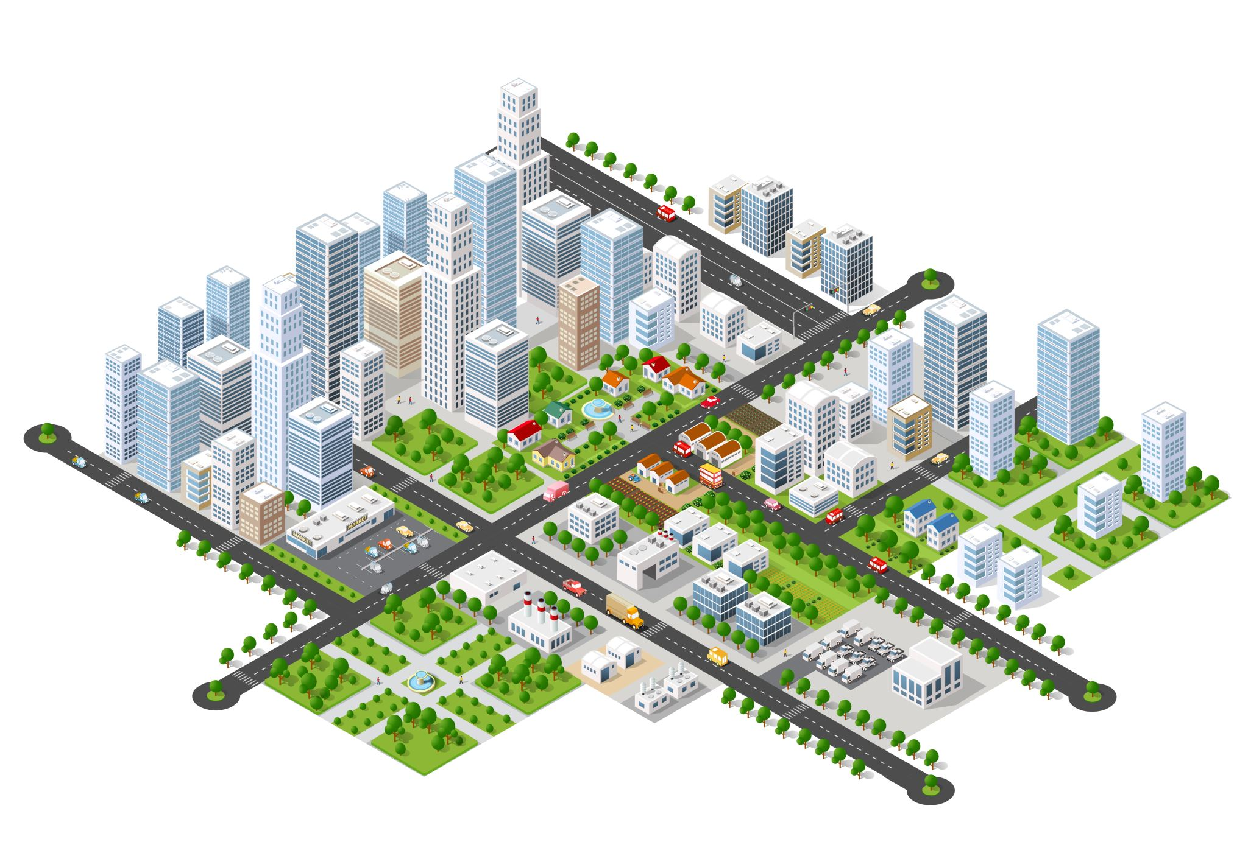


City Microclimate and Traffic Analysis
Fyrogeni Ariadne 1083816
Psychogiou Georgia 1083979

Slide 2

Microclimate
Environmental Variables
Climatic conditions measured in localized areas, especially when these differ from the climate of the surrounding regions.
temperature
light
wind
humidity
frost
rain
air quality
For example, the climate may differ between:
a seaside area and the city centre (Bozaitika and Patras centre)
a junction and its surroundings

Slide 3

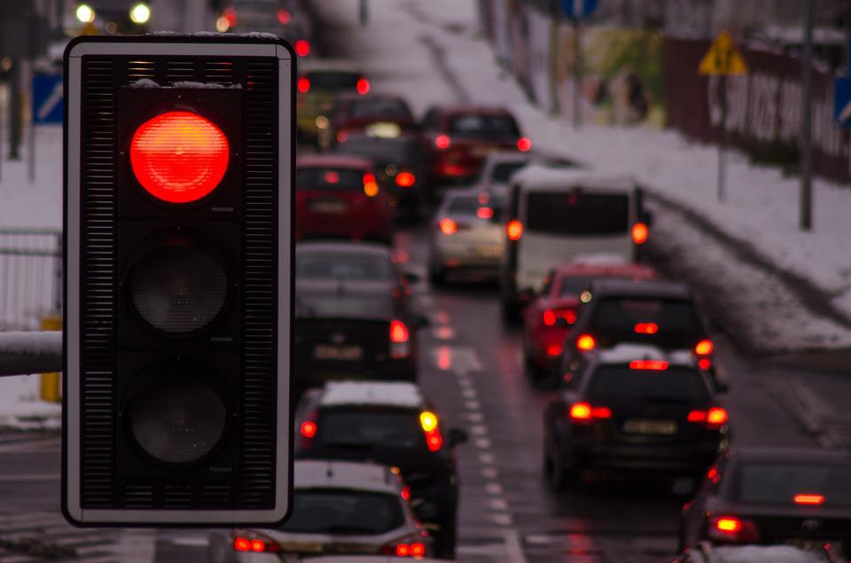


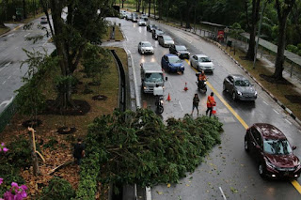


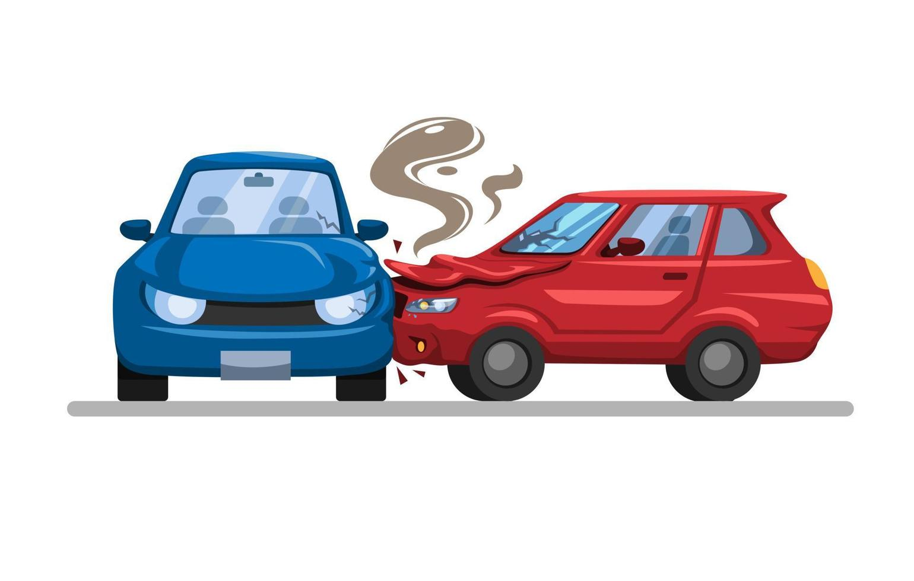


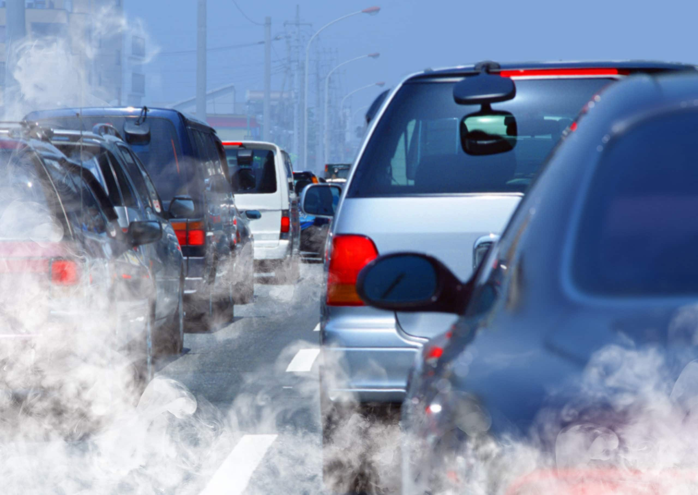


Circulation Problems
Urban Heat Island Effect
Circulation delays in junctions and traffic lights
Traffic obstruction due to floods , fallen trees
Numerous car accidents
Poor air quality and visibility caused by vehicle emissions
Congestion of visitors in places of interest
Notes:
συμφόρηση

Slide 4
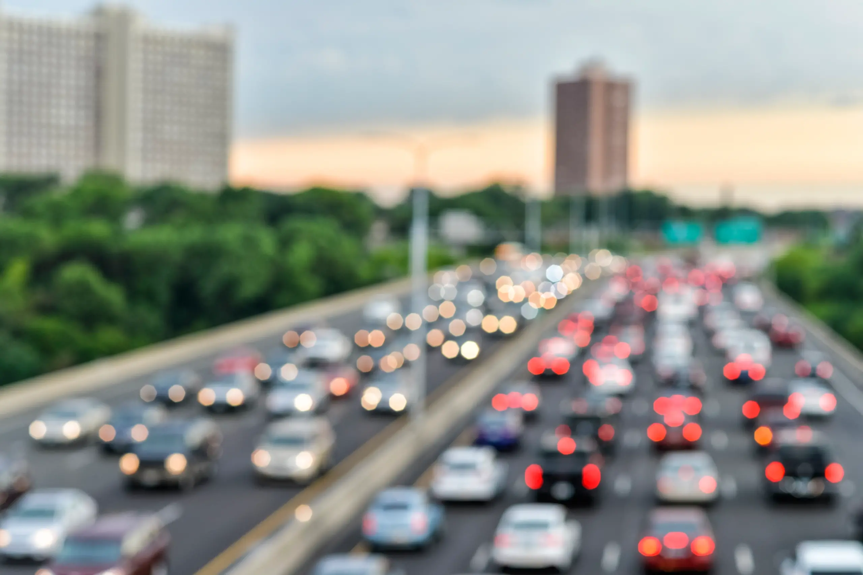
Solution
Accurate microclimate forecast and report
Estimation of traffic delays and waiting times in congestion points
Alerts notifying for traffic complications and severe weather phenomena

Slide 5




OUR IDEA Study of the correlation between weather conditions and traffic situation in specific areas.
Our idea
Aspects of traffic circulation
cars | bicycles | electric scooters | pedestrians

Slide 6
Data sources
Google maps
Google places
Weather APIs (OpenWeather, Copernicus)
Lab provided sensors
Microclimate – Traffic Correlation

Slide 7
Sensors
Air temperature (BARANI, MeteoHelix IoT Pro)
Humidity (BARANI, MeteoHelix IoT Pro)
Sun intensity (BARANI, MeteoHelix IoT Pro)
Rain amount – flood (BARANI, MeteoRain 200 Compact - MClimate, Flood sensor)
Wind speed and direction (BARANI, MeteoWind IoT Pro)
CO2 (MClimate, CO2 Sensor & Notifier)
Sound level (Dutch Sensor Systems, Ranos dB 2)

Slide 8

Target group
European Union
(TRAN)
Ministry of Infrastructure and Transportation
Ministry of Climate Crisis and Civil Protection
Construction and public transport companies
Municipal Authorities
Citizens
Notes:
Committee on Transport and Tourism (επιτροπή)
Υπουργείο κλιματικής κρίσης και προστασίας του πολίτη
Υπουργείο υποδομών και μεταφορών

Slide 9
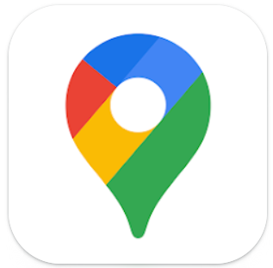

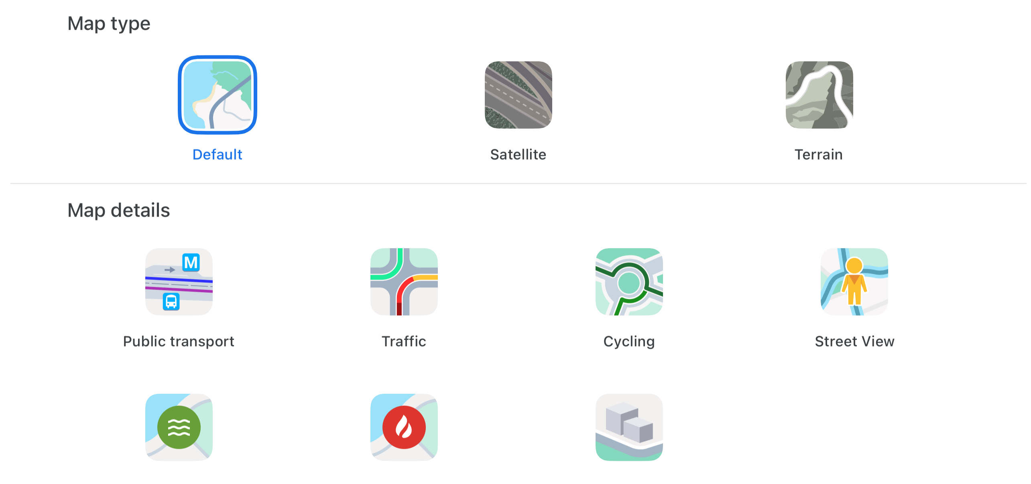
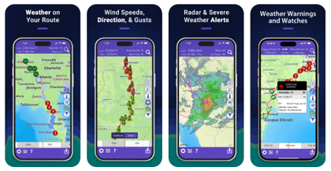
Google Maps is an app that provides real-time traffic con-ditions, delays and alternative route suggestions. However, route planning and the ability
Drive weather app is designed to show road conditions by analyzing forecasted weather and send users severe weather alerts. It enables you to see
to adjust departure times based on micro-climates is unavailable and weather insights are indirect and not detailed. A recent update, also offers safety alerts about weather-related hazards (such as floods).
how conditions like rain, snow, or storms may impact different parts of your route. This app also includes options for adjusting departure times to avoid weather-related delays.

Slide 10

Differentiating factor
Focus precisely on areas presenting traffic problems in a city
Traffic analysis not based on navigation routes for drivers but on city’s needs (historical analysis, correlation insights)
Constantly updated real data
Traffic-related problems prevention

Slide 11
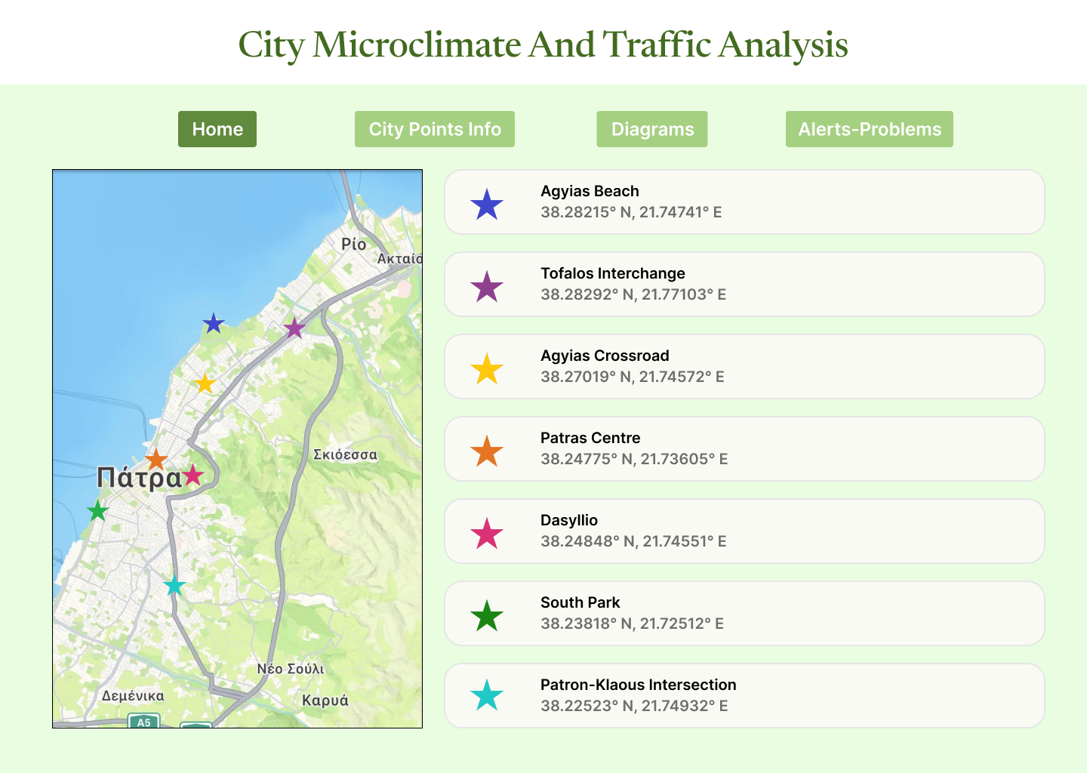

W
E
B
S
I
T
E
D
R
A
FT
Notes:
Urban Heat Island Effect

Slide 12
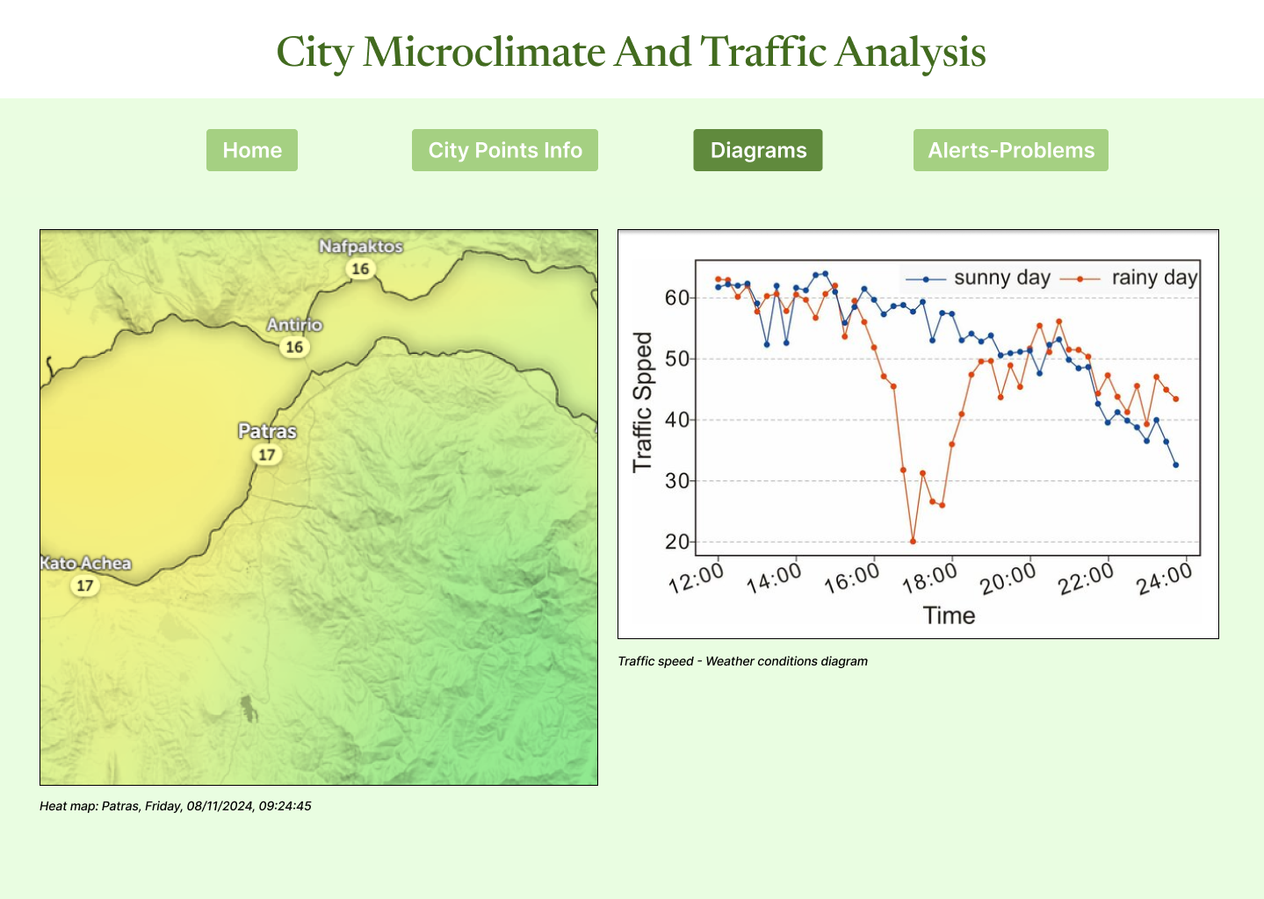
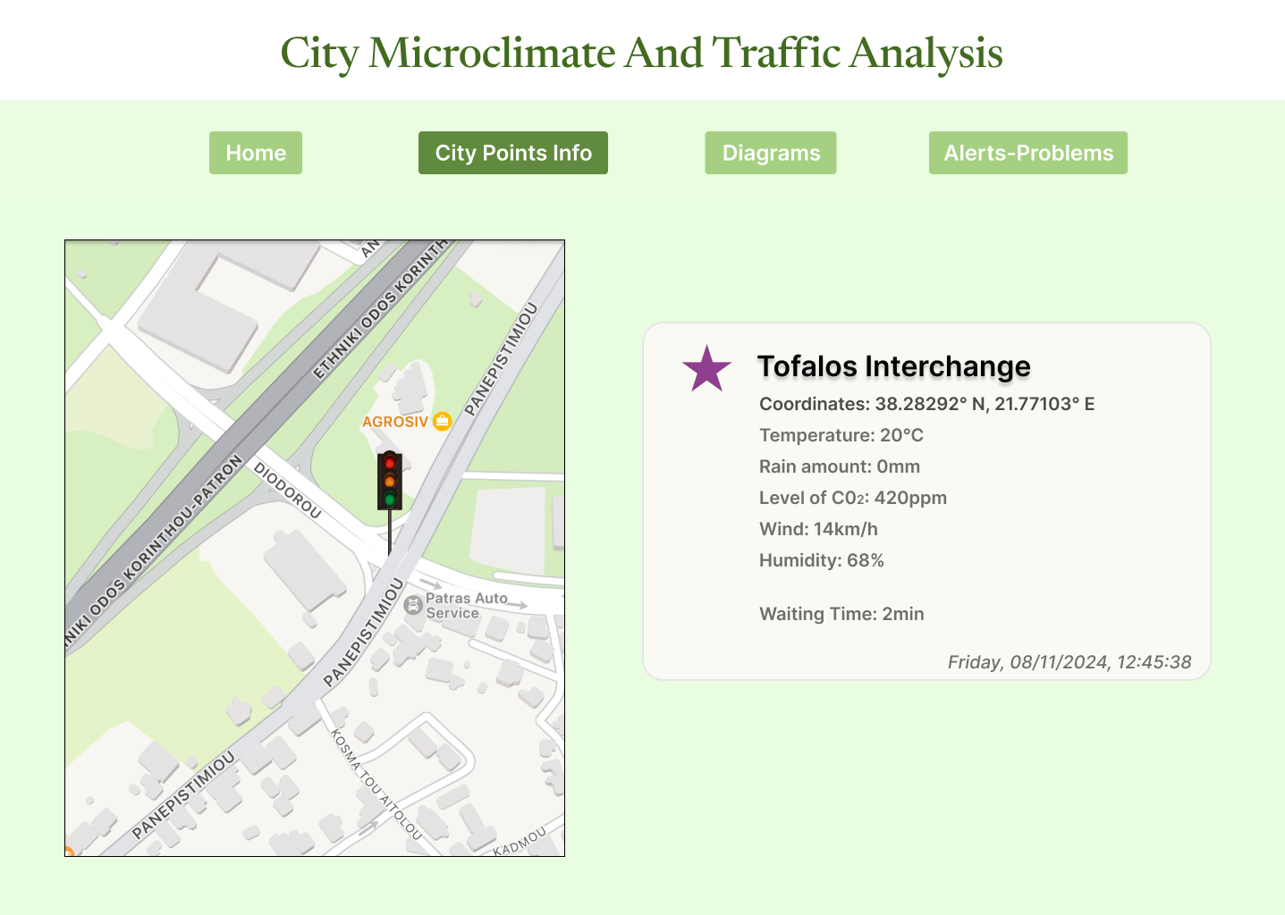

Slide 13
THANK YOU!
Any questions?

